Slide 1


Educational intervention for students with High Intellectual Ability:
Development of cognitive, academic, and socioemotional skills
Diego Lería Ugarte
Predoctoral researcher
Department of Educational Sciences, Faculty of Arts and Education, University of La Rioja
Directors: Sylvia Sastre i Riba, Christoph Perleth, & Antoni Castelló Tarrida
1

Slide 2
Linguistic and cultural adaptation of the LemaS Survey
Future research lines
Spanish programmes for educational attention to HIA learners
The educational system in Spain and its approach to giftedness and talent
Three Meta-Analyses to Determine the Effects of Enrichment on High Intellectual Ability (HIA) Learners
5
4
3
2
1
2

Slide 3
Three Meta-Analyses to Determine the Effects of Enrichment on High Intellectual Ability (HIA) Learners
1
3

Slide 4

1.1. High Intellectual Ability Education s
(Lería-Ugarte & Sastre-Riba, in Press)
Challenge
The expression of high intellectual potential
Neurobiological predictor – endogenous and exogenous modulators
(Sastre-Riba, 2020)
Among exogenous factors, education plays an important role
Adjusting educational attention to people with HIA (Riedl-Cross & Cross, 2022):
  Individual need
  Investment in a sustainable future for society
Educational context
Fragmentation
HIA learners
They require educational programmes tailored to their high potential, intellectual profile, and well-being
Diversity
(Reis et al., 2021; Sternberg & Ambrose, 2021)
These educational needs might be expressed at the following levels:
  Cognitive (Elballah et al., 2024)
  Academic (Kaul et al., 2016)
  Socioemotional (Gubbels et al., 2014)
  Ethical (Sastre-Riba, 2026)
4

Slide 5

1.3. Curricular and extracurricular enrichment s
(Lería-Ugarte & Sastre-Riba, in Press)
ENRICHMENT
↓
Strengthen the application of interdisciplinary methodologies
Encourage the expression of high potential and promote well-being
Create novel products
(Brigandi, 2019)
OBJECTIVE
↓
To analyse the current state of enrichment programmes and partial enrichment globally, and their effects on the cognitive, academic, and socioemotional development of learners with HIA
5

Slide 6
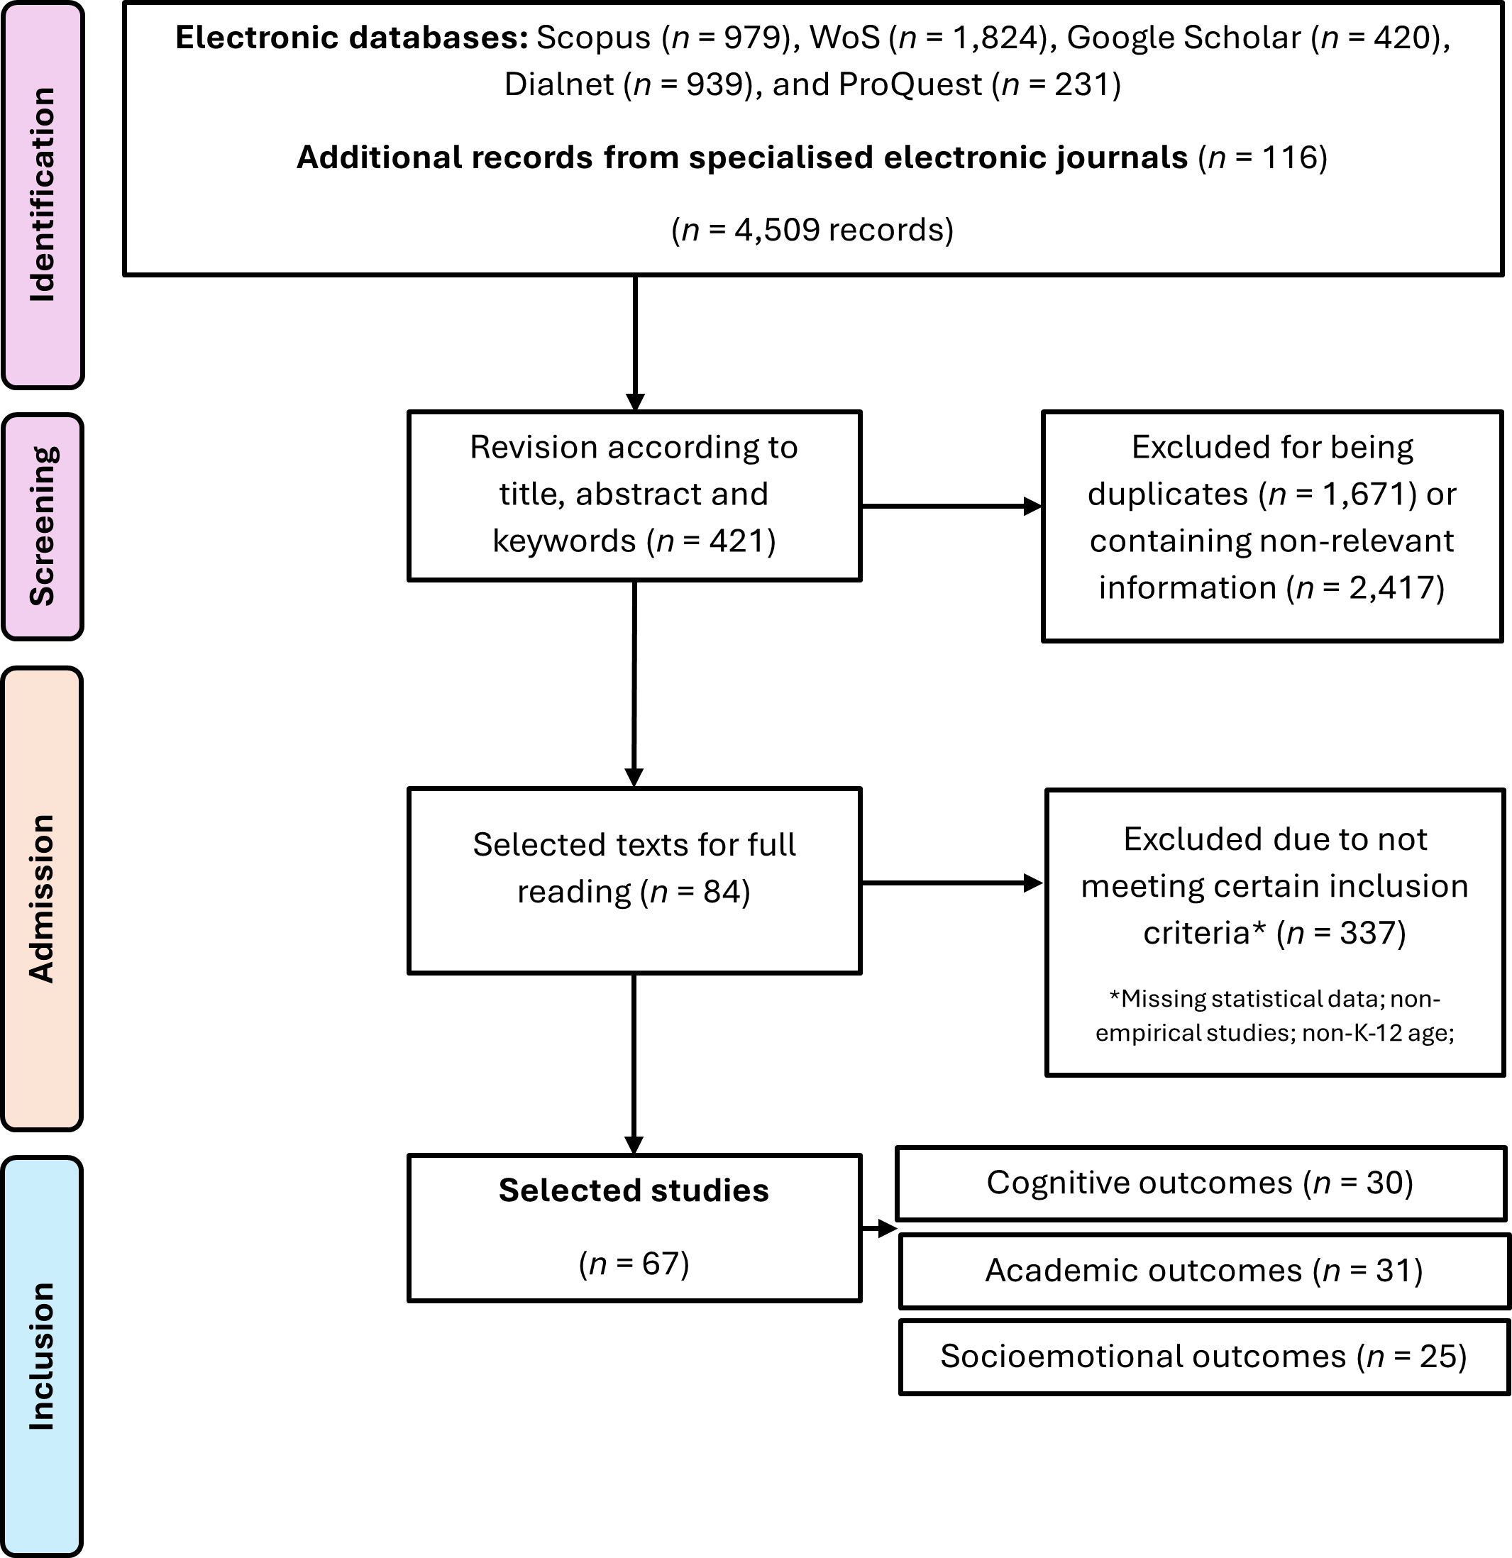
1.4. Method
(Lería-Ugarte & Sastre-Riba, in Press)
Systematic review: 11/24 - 12/24
  Repetition of data extraction: 09/25 - 12/25
  kc = 0.851 (high level of intra-observer agreement)
Inclusion and exclusion criteria:
  Be empirical in nature.
  Involve two groups of learners (experimental and control) or one group with pre-post measures.
  Cover the age range corresponding to K-12.
  Regarding the enrichment program: (a) include curricular or extracurricular enrichment strategies, and (b) exclude educational intervention programs based entirely on acceleration.
  Monitor any of the following indicators: cognitive development, academic achievement, and socioemotional development.
  Provide the appropriate statistical data to calculate the effect size.
  Be published in an English or Spanish-language journal indexed in JCR or SJR metrics.
  Be published between 2010 and 2025.
Meta-analyses
  Calculation of the effect size for each empirical study
  Calculation of the pooled effect size and confidence interval
  Assessment of empirical heterogeneity
  Assessment of publication bias
  Sensitivity analysis
  Analysis of moderating variables
6

Slide 7
1.5. Results: the impact of enrichment programmes s
(Lería-Ugarte & Sastre-Riba, in Press)
1
Each scientific record employs different terminological criteria
2
Distribution of effect sizes → a tendency toward a positive effect of enrichment programs (total or partial) on the development of HIA learners
3
The three meta-analyses demonstrated a positive and significant effect (p < 0.001) of the programmes
The nature of the studies was not homogeneous
4
Sensitivity analysis:
5
The high empirical heterogeneity could be explained by the influence of moderating variables. These include:
  + It helped to reduce empirical heterogeneity
  – It produced a systematic reduction in the effect size of these programs
  From a medium-high effect to a medium-low effect
  Cognitive studies:
  grade level
  Academic studies:
  type of study / sample size / region
  Socioemotional studies:
  none of the assessed moderator variables
7

Slide 8
1.7. Conclusions: the impact of enrichment on HIA learners s
(Lería-Ugarte & Sastre-Riba, in Press)
Enrichment
It is a desirable educational strategy IF it is properly justified, implemented, and measured in terms of effectiveness
Achievement of the main objective
  It demonstrated (as Gül & Ayık, 2026; Kim, 2016) the OVERALL TREND towards POSITIVE, SIGNIFICANT, AND MODERATE EFFECTS of enrichment programmes (or partial enrichment) on the development and education of learners with HIA (Brigandi et al., 2018; Elballah et al., 2024; Gubbels et al., 2014)
  It faced: conceptual disparity and lack of clarity regarding the nature of HIA and its cognitive, academic, and socioemotional approaches to educational personalisation
A high level of impurity that cannot be explained by publication bias
Common underlying pattern: a high degree of heterogeneity → moderating variables
  A wide range of backgrounds that result in different strengths, weaknesses, and needs regarding educational participation (Sternberg & Ambrose, 2021)
Influence of atypical studies
NEED for research and educational intervention in HIA to be based on scientific evidence that has been applied and evaluated for its effectiveness
NEED for more research with greater conceptual clarity on the nature and development of HIA and its effectiveness
8

Slide 9
The educational system in Spain and its approach to giftedness and talent
2
9

Slide 10
2.1. Governance of the Spanish educational system
2.2. Educational stages
2.3. Internal organisational structure of an educational institution
2.4. Attention to diversity and educational inclusion in Spain
10

Slide 11

2.5. Specific attention for HIA learners
The education administrations shall provide the necessary resources to ensure that all pupils achieve their full personal, intellectual, social, and emotional potential, as well as the objectives set out in general terms in this law.
It is the responsibility of the education administrations to ensure that the necessary resources are provided so that students who require educational attention different from the standard provision, […] due to their high intellectual abilities […], can achieve the fullest possible development of their personal abilities and, in any case, the objectives set out generally for all students.
LOMLOE (2020, p. 122909)
Acceleration
The duration of the stage can be reduced by one year
Assess previously personal well-being and socialisation
Develop curricular enrichment plans designed to improve the skills of those pupils who need it
From Primary School onwards
NO common protocol across the 17 autonomous communities + low detection rates (under-diagnosis) + a lack of training for teaching staff
11

Slide 12
Spanish programmes for educational attention to HIA learners
3
12

Slide 13

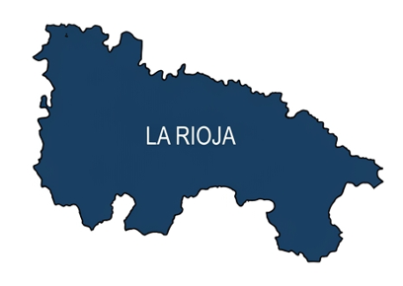



3.1. Diversity in program offer by autonomous community
The principles of inclusion and equity are not always guaranteed for the group with HIA
  INEQUALITY IN SPAIN: disparities in educational provision between regions and the need for training for school leaders, counsellors, and teachers.
(Elena Monleón et al., 2025)
The following examples are offered to illustrate this phenomenon
The National Confederation of Associations for High Abilities (CONFINES) highlights the need for changes to education to ensure adequate attention in both the educational and social spheres.
13

Slide 14
3.2. La Rioja
3.3. Madrid
3.4. Murcia
3.5. Illes Balears
14

Slide 15
Linguistic and cultural adaptation of the LemaS Survey
4
15

Slide 16
4.1. Linguistic adaptation: semantic and cultural equivalence
4.2. Cultural adaptation: conceptual and institutional equivalence
16

Slide 17

4.3. Process outcomes and evidence of validity
Initial translation
Back-translation
Pilot study (n = 23)
Expert judgements
Final version
Evidence of validity
Pilot study
  To assess the questionnaire’s comprehensibility, clarity, and internal consistency.
  Questionnaire evaluation: suitability for the objective, comprehensibility and repetition of questions, addition or removal of items
Content validity
  Three judges assessed the adaptation of the questionnaire items according to four criteria: adequacy, consistency, relevance, and clarity.
Internal structure validity
  Confirmatory factor analyses
17

Slide 18
Future research lines
5
18

Slide 19
Descriptive analysis, reliability testing, normality assessment, correlational analysis, and hypothesis testing
Cross-cultural comparative analysis (Spain – Germany)
Mixed-methods integration (quantitative + qualitative)
Network analysis (centrality indices, expected influence, and network stability)
Factorial analysis and hypothesis testing
Cluster analysis (profile identification)
Text mining or sentiment analysis
19

Slide 20

Diego Lería Ugarte
e-mail: diego.leria@unirioja.es
Presented at the
University of Rostock,
Faculty of Philosophy,
Institute of Educational Psychology "Rosa and David Katz“
on 21st and 28th of May

